Slide 1




Team Name – Bug
Programmer’s Date
Organised by -
Theme - Track A bed

Slide 2

01
Problem Statement
There is a lack of a unified platform to link the existing data of hospitals in our area so that we can overpass the hastle of finding the hospital with free beds and facilities available, so as to reduce the risk of getting infected and avoiding crowd at hospitals.
This covid pandemic has came as a health emergency for our healthcare system so such an platform is extremely needed to inform the patients of the data related to Hospital. The existing solutions lack transparency and do no cope up the need of the patients end.

Slide 3
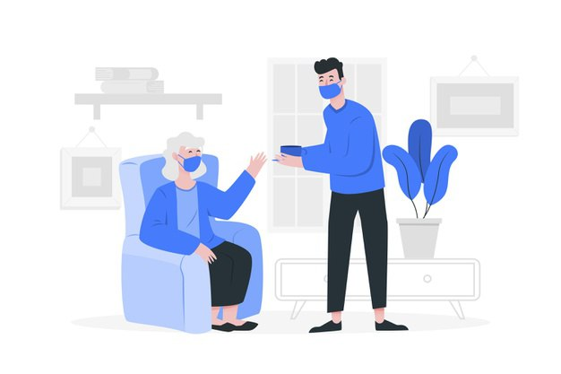
Solution
Our solution is a two-way system between a user and health provider.The solution that we’ll develop is a web application named Sewak App, which leverages information from a patient questionnaire regarding COVID-19-related symptoms and up-to-date information from medical centers to provide optimized medical center suggestions to patients for their needs.
Our platform can provide support by medical centers around the country, they will be able to provide critical up-to-date information such as: number of COVID-19 tests, number of available ventilators, PPE status, number of COVID-19 patients, type of medical facility(full care, testing only, non-COVID only) to help further guide our algorithm on matching patients with the correct hospitals. Furthermore, we hope to make this data accessible to all medical institutions accessing our database.

Slide 4

ENABLING TECHNOLOGY TO FULFILL THE NEEDS
SEWAK

Slide 5
Positive and Unique Features
Single Platform for all Health related queries
Detailed Information by Hospital
Link between patients and
volunteers
Real-time data by Crowd Sourcing
Voting System
Real-time Location by Here Map

Slide 6

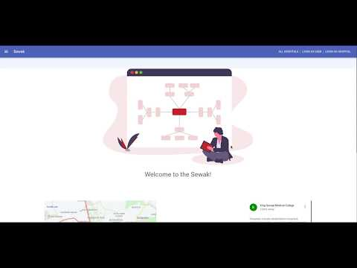
Product Demo

Slide 7









Front-End |  | Backend |  | API
 | ReactJS |  | NodeJS
 | Redux |  | Express |  | HERE Maps
 | Material UI |  | MongoDB |  | REST
Technology
Stack

Slide 8

Identity and Security Concerns
Facilitating the onboarding process for legitimacy of users by proof of identity documents and video recording based manual KYC.
Also it would offer a seamless user experience and enable smooth self onboarding journey for parties involved.

Slide 9

Future Plans
Book an appointment in Hospital
eKYC for identity verification of hospitals and onboarding users.
Covid Emergency Response.
Slot Time Booking.
Chat interface between User and hospital.

Slide 10
Thank You!
We are open for any queries and suggestions.
Programmer’s date

